Slide 1
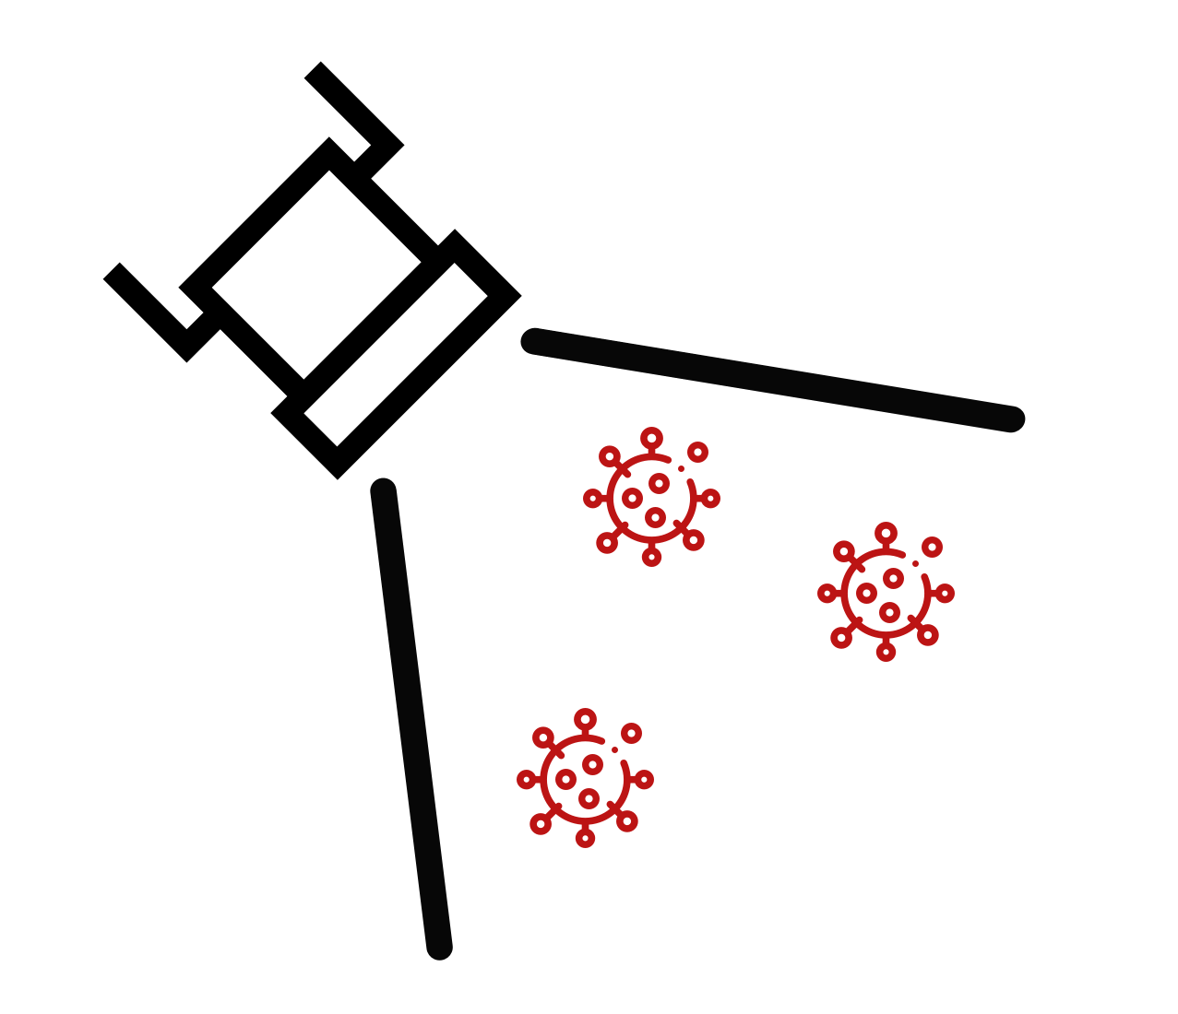
FloodLAMP Biotechnologies
Collection kits to take
You can pool up to 4 swabs per tube.

Slide 2
FloodLAMP Biotechnologies
Return your samples here
Visit floodlamp.bio/[site] for updated testing schedule and program information.
If you missed the pickup, please text [Admin Name at phone] and bring your sample to [Address] right corner.
Not yet picked up
Pick up complete

Slide 3
FloodLAMP Biotechnologies
Return your samples here
Visit the FloodLAMP App - “Returning Your Samples” from the upper left menu for updated testing schedule and who to contact if you miss the pick up time.
Not yet picked up
Pick up complete

